Slide 1

WAKULIMA FARM TECH
Crop & Fertilizer recommendation and Disease prediction
By Samuel Gathogo, Stacy Waweru, Calvin Otieno, Rahim Njagi ,Margret Namunyak

Slide 2
OBJECTIVE
Our project aims to develop an intelligent Crop and Fertilizer Recommendation and disease prediction System, that assists farmers in making well-informed decisions for crop and fertilizer selection and also disease detection. By leveraging machine learning and data analytics, this system will:
Promoting efficient and sustainable agricultural practices.
Helping farmers address the exact nutrient needs of their soil for each chosen crop.
Optimize overall resource use, improving crop health, yield, and economic efficiency while minimizing environmental impact.

Slide 3
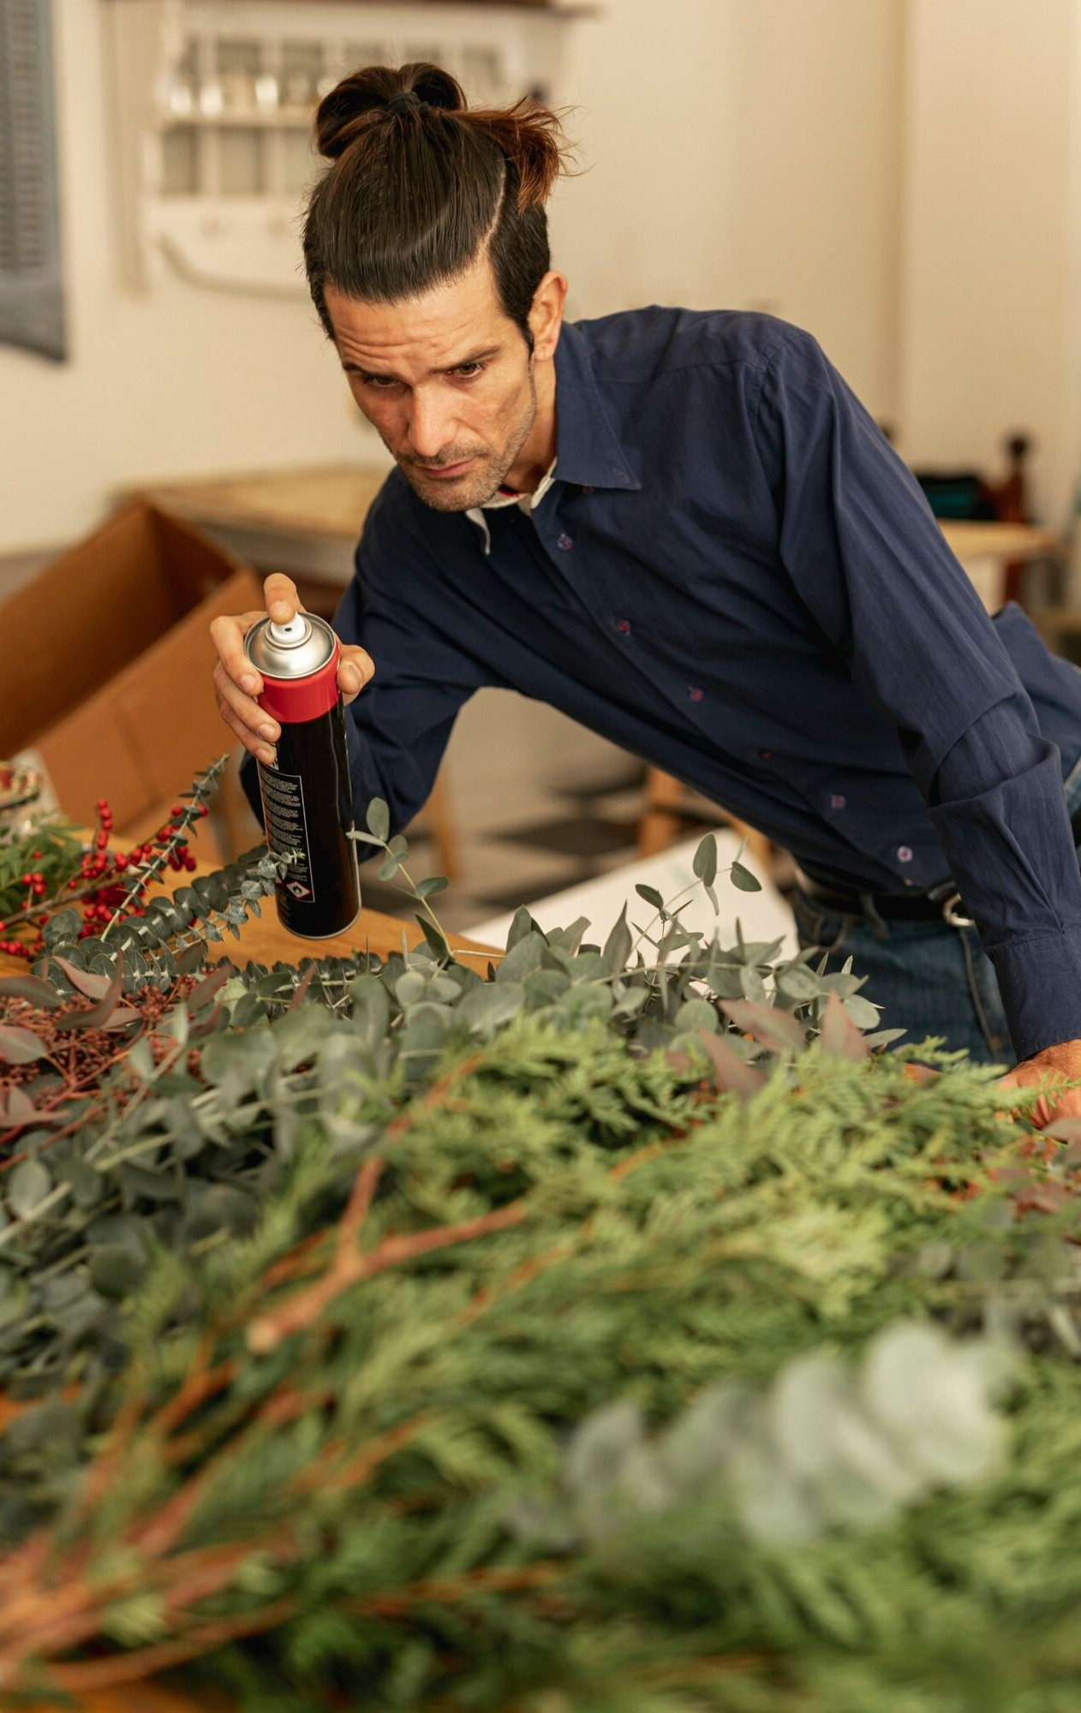
BUSINESS UNDERSTANDING Farmers face significant challenges in managing soil nutrients, selecting the right crops for their land and determining crop diseases. Choosing appropriate fertilizers and crops is essential for healthy yields, yet this can be complex without data-driven insights. Key challenges include: ->Nutrient Imbalance ->Soil Degradation ->Economic Loss

Slide 4
Problem Statement Farmers face significant challenges in optimizing crop yields and maintaining soil health due to difficulties in selecting appropriate crops, managing fertilizers effectively and identifying diseases that crops have. Without precise, data-driven guidance, farmers often struggle with: ->Nutrient Management ->Crop Selection Uncertainty ->Economic Impact ->Disease Identification

Slide 5
Solutions and Benefits -> Crop Recommendation: Recommends crops suited to local soil and climate, enhancing productivity and resilience. -> Fertilizer Recommendation: Provides precise fertilizer type and dosage based on soil nutrients, supporting balanced growth and preventing degradation. -> Disease Classification: Identifies and classifies plant leaf diseases based on uploaded photos . -> Cost Optimization: Reduces unnecessary input costs through targeted recommendations, achieving savings while maintaining high yields. -> Sustainable Farming: Minimizes environmental impact by reducing nutrient runoff and preventing soil degradation. -> Personalized Recommendations: Tailors advice to each farm’s unique soil and climate conditions for optimal crop growth.

Slide 6

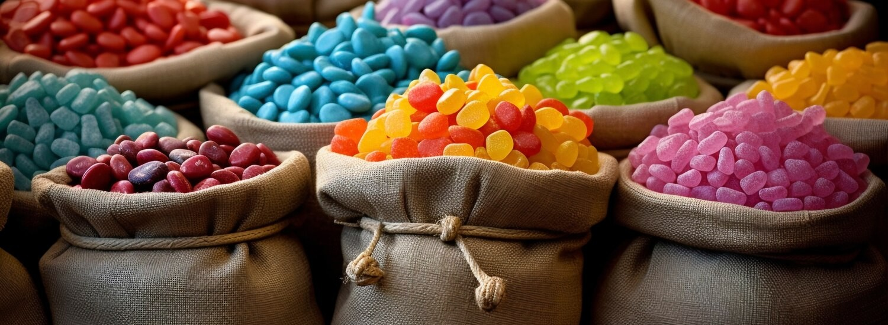
DATA OVERVIEW
Recommendation Systems are trained on datasets the ‘Crop data’ and ‘Fertilizer Data’ with 2,200 samples and 8 key features that inform both crop and fertilizer recommendations:
N, P, K: Nutrient levels in the soil—nitrogen, phosphorus, and potassium.
Temperature, Humidity, pH, Rainfall: Climate and soil conditions that influence crop suitability and fertilizer requirements.
Crop Type: The crop label, which helps the model learn and predict optimal choices based on specific nutrient needs and environmental adaptability.

Slide 7

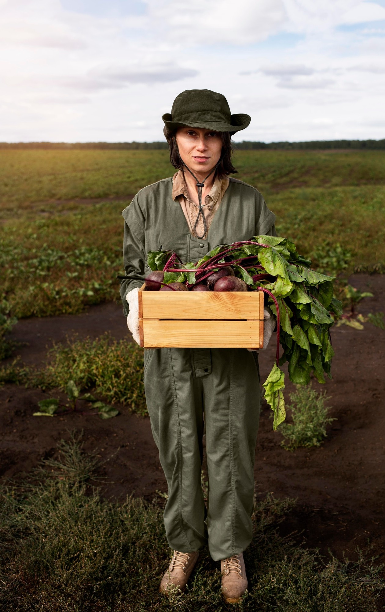
DATA PREPROCESSING
´Steps Taken:
Data loading & cleaning
Exploratory Data
Analysis Modelling
Deployment´Tools
Libraries: We imported several libraries from
Basic data manipulation, Preprocessing models,
to Decision Tree model , Logistic Regression Model, XGBoost among others.

Slide 8

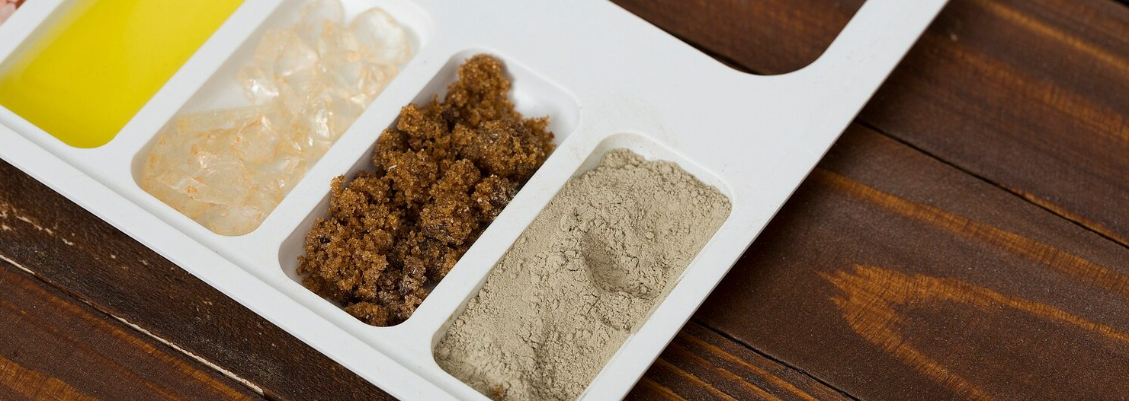

Tools used:
Python libraries
Machine Learning Models (Decision Tree model , Logistic Regression Model, XGBoost among others.)
Flask
YOLO
Heroku

Slide 9

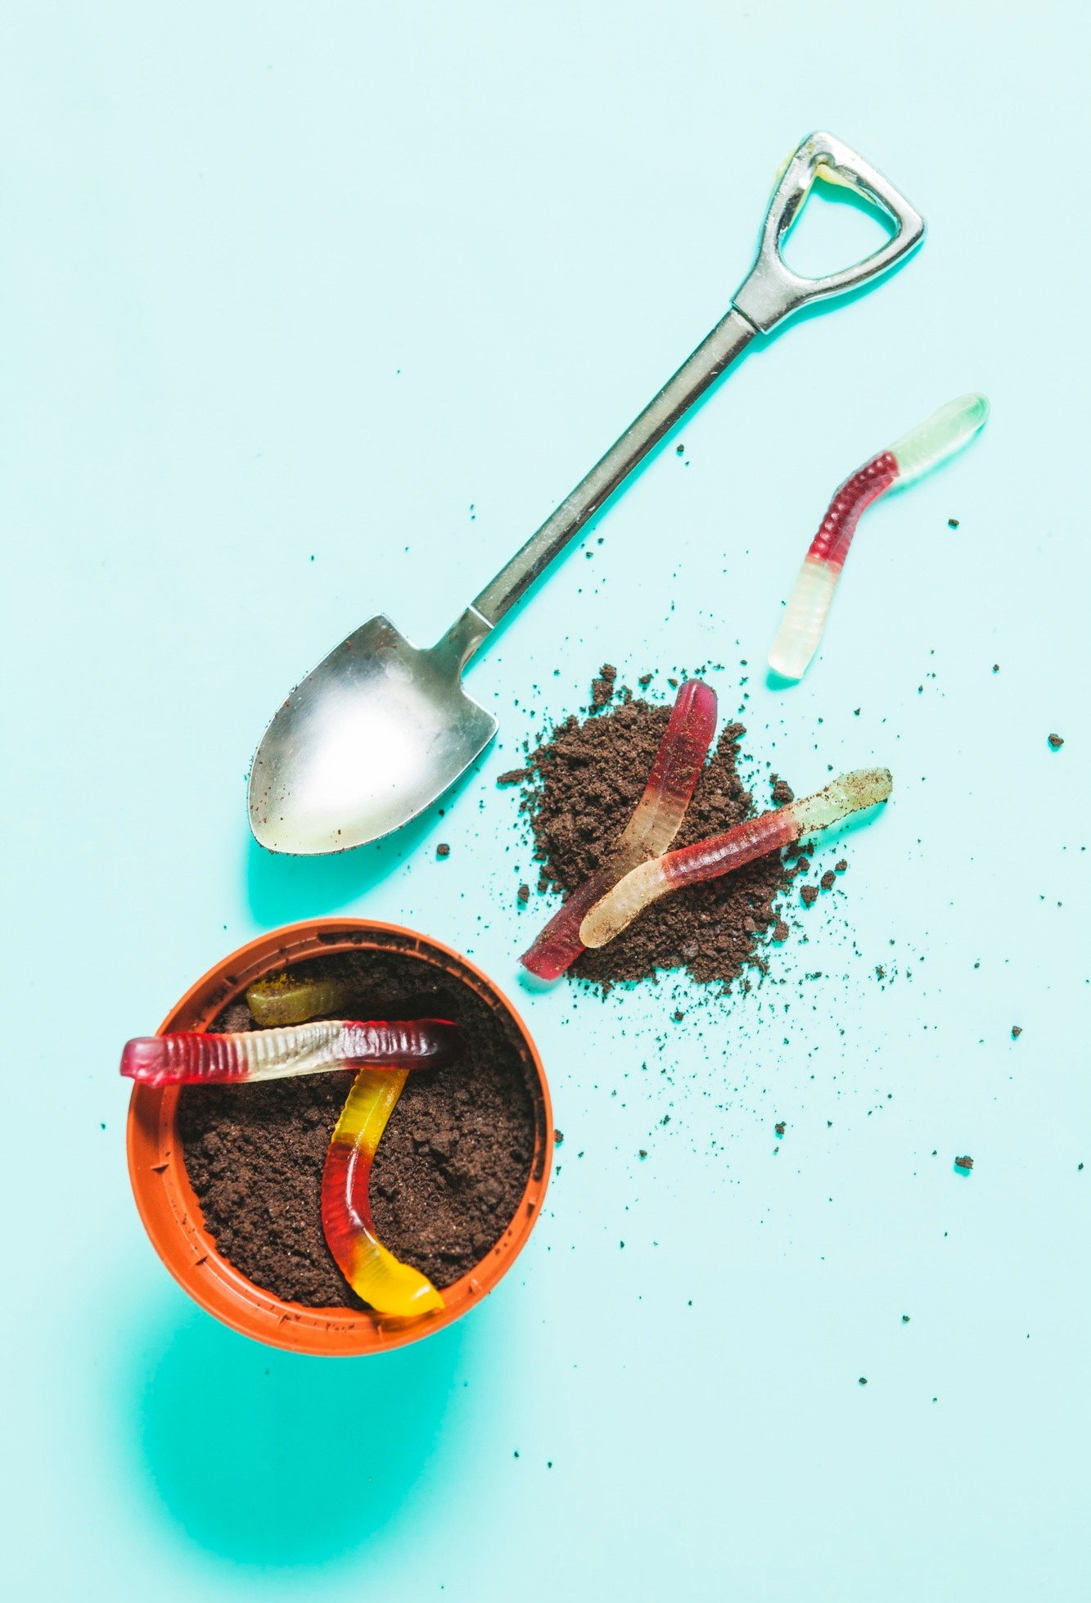
Model Deployment
Deployment Strategy: A web-based platform lets farmers input data and receive real-time crop and fertilizer recommendations and disease classification.
APIs and Web Services: APIs enable instant feedback by connecting the model with the web interface.
Farm Management Integration: Integrates with larger farms' systems for data sharing and improved decision-making.
Tools Used:
Flask for backend API development
Heroku for scalability

Slide 10
CONCLUSION
Random Forest performed the best, achieving an accuracy of approximately 99.1%. The model demonstrated high precision and recall for most crop classes.
Different farmers are able to get personalized recommendation based on the best prediction model with regard to the location and other factors.
Disease classification and identification is made possile using YOLO.
Identification will enable farmers to correctly predict crop diseases, which then improves productivity.

Slide 11
RECOMMENDATIONS
Model Choice: Recommend Random Forest or Gaussian Naive Bayes for accuracy; Logistic Regression if interpretability is key.
Class Imbalance Management: Employing techniques like oversampling, undersampling, or class-weight adjustment to address imbalances and improve model performance on minority classes.
Feature Engineering and Hyperparameter Tuning: Optimize temperature, humidity, and pH features, along with hyperparameters, to improve precision and recall.
Data Enrichment: Gathering more data for underperforming crops.
Enhanced Recommendations: Expand to include seasonal crop planning and pest/disease prediction to support crop health and yield.

Slide 12

ANY QUESTIONS ?

Slide 13

THANK YOU!
For more information, reach out to: Stacy Waweru, Samuel Gathogo, Calvin Otieno, Rahim Njagi, Margret Namunyak
This project is available on our github (https://github.com/samuelMG1/PROJECT-PHASE-5)

